Slide 1
Directory Structure
P Kartikeya Raj
2023001492

Slide 2
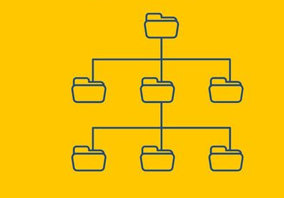
Why is a Directory Structure Needed?
Organizes files efficiently
Prevents name conflicts
Improves security & accessibility

Slide 3
Types of Directory Structures​
SINGLE LEVEL DIR
TWO LEVEL DIR
TREE DIRECTORY ​
All files stored in one directory
Pros: simple and easy
Cons: name conflicts, no hierarchy
Each user has their own directory
Pros: avoids name conflicts
Cons: no subdirectories
Hierarchical organization
Root -> user -> subfolder
Pros: best for modern os, ……flexible, secure
Cons: more complex

Slide 4
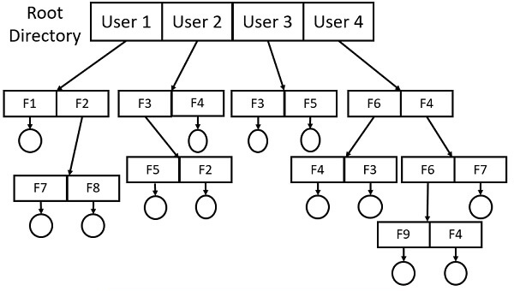
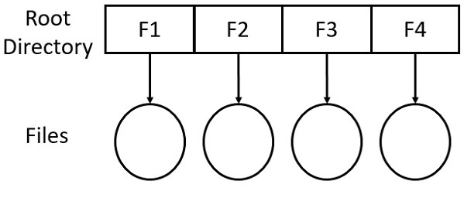
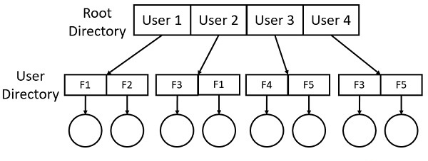
Types of Directory Structures​
SINGLE LEVEL DIR
TWO LEVEL DIR
TREE DIRECTORY ​

Slide 5
Thank You

